Slide 1

The Battle of Neighbourhoods week2
--Jyothika

Slide 2
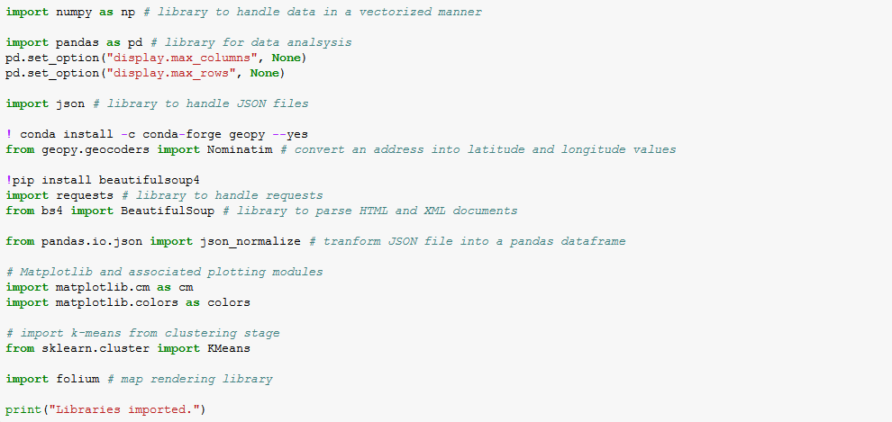
1.Download and explore data-sets
These are the packages which are used to download and explore data sets. It contains JSON file and we have to convert it into a data frame.

Slide 3
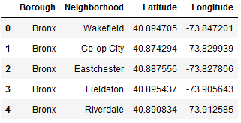
Explore data-sets
This is the data frame which is obtained form the json file

Slide 4
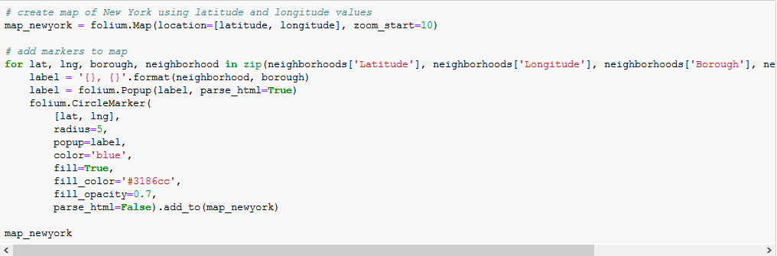
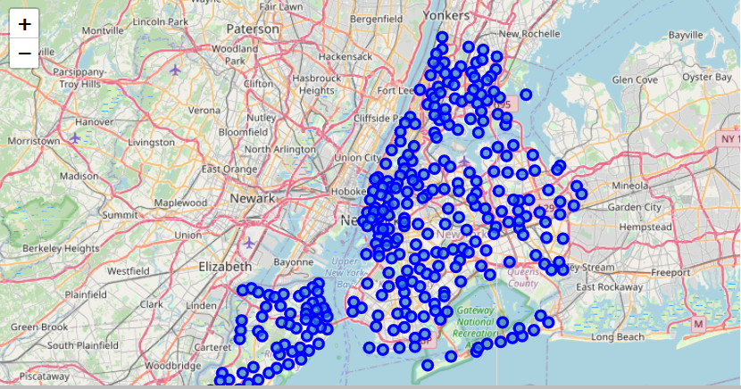
This is the map of New York with neighborhoods superimposed with latitudes and longitudes

Slide 5

Using four-square application
We use ClientID, client secret and version to get the details of the nearby location using these details

Slide 6
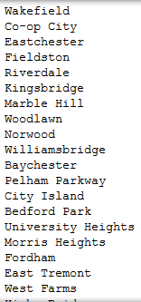
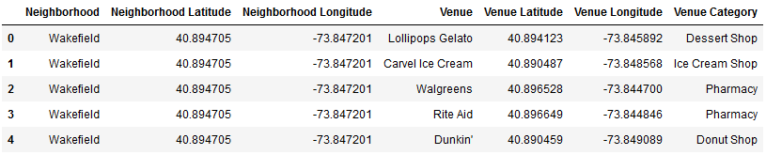
New York venues

Slide 7
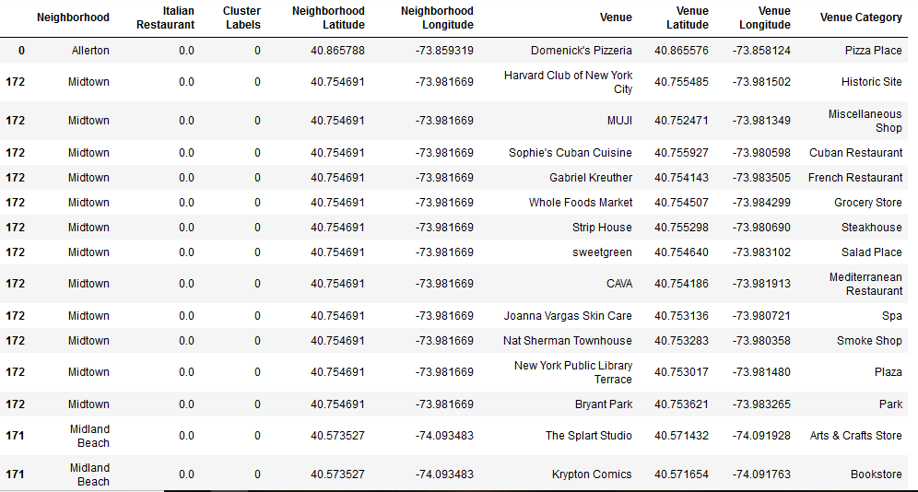
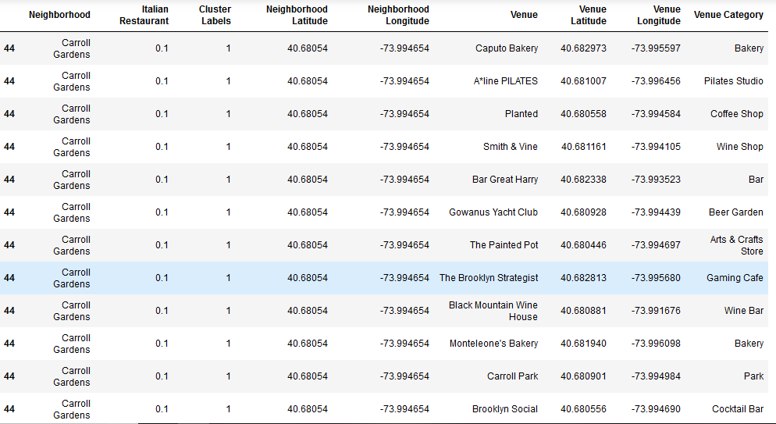
clustering
Cluster 0
Cluster 1

Slide 8
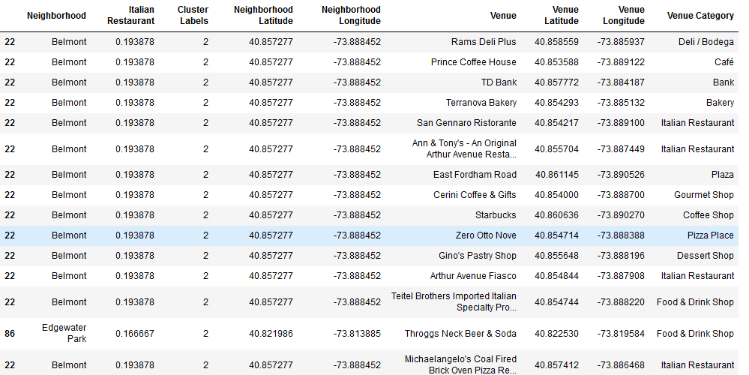
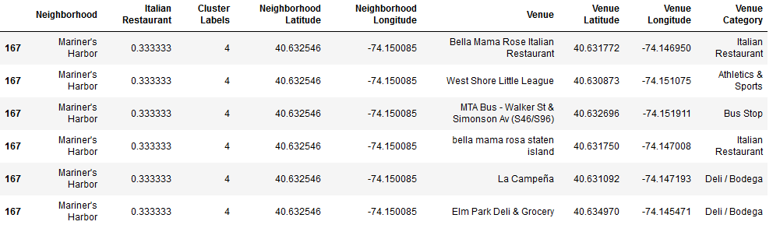
Cluster 2
Cluster 4

Slide 9
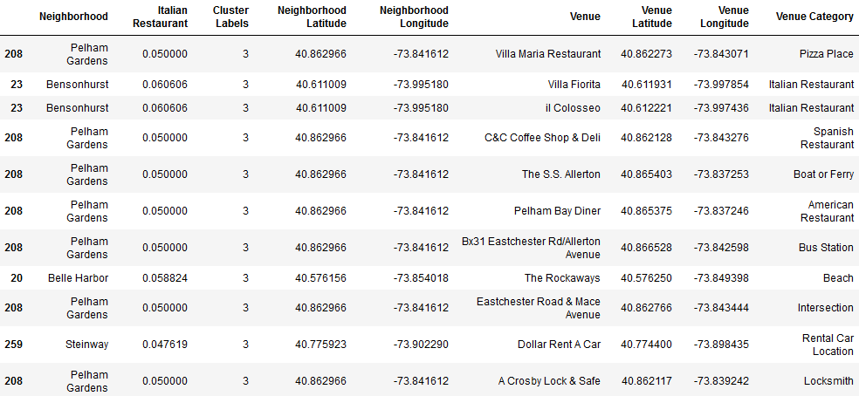
Cluster 3
By observing the data frame It seems that Cluster 3 will be the area that gathers the Italian Restaurant most intensively
Bensonhurst seems to be the neighborhood that incorporates the most Italian restaurants, which could also be verified by venues' names.

